Slide 1
The Balkan States as part of Europe The Political Economy of Subsidiarity?
Hardy Hanappi
Ad personam Jean Monnet Chair for Political Economy of European Integration
University of Technology of Vienna, Economics
www.econ.tuwien.ac.at/hanappi/ hanappi@tuwien.ac.at

Slide 2
Overview
Motivation
The current state of the European unification process
Integration of Europe‘s South-East
Theory: From subsidiarity to network design
Practice: Europe‘s problems – implications for Balkan states

Slide 3
Motivation
European Studies provide a large amount of interesting material and case studies …
… but theory (and practice) synthesising them is rare.
Mainstream economic theory is using an interesting mathematical apparatus …
… but it is in most cases not applicable to political economy.
Europe‘s South-East is a pivotal element in the unification dynamics …
… but scientific approaches to model the dynamics of its political economy are missing.

Slide 4
The current state of the European unification process - 1
Real GDP
Unemployment

Slide 5
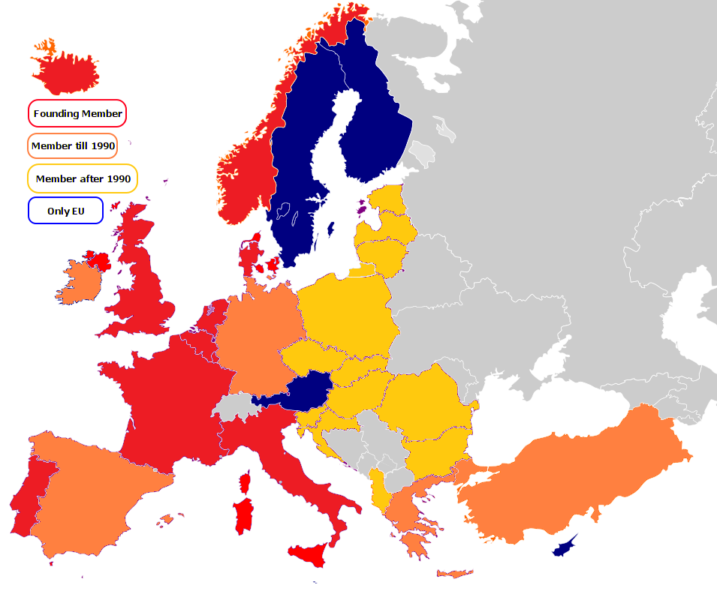
The current state of the European unification process - 2
NATO expansion
Government debt

Slide 6
Integration of Europe‘s South-East
Turkey and Greece become NATO members
Greece becomes EU member state in 1981
Balkan War
After 2004 in EU: Slovenia, Cyprus, Bulgaria, Romania, Croatia
Slovenia, Greece, and Cyprus are in the Eurozone
Economic Integration ? (Input-Output Analysis, etc.)
Political Integration ?

Slide 7
From subsidiarity to network design - 1
Subsidiarity
Decision 1
Entity 1
Decision 2
Decision 3
Decision 4
Entity 2
Entity 3
Decision 5
Decisions are only transferred to higher level entities if they cannot be (better) performed at the lower level.
Decision 1
Decision 1
Decision 2
Decision 2
Decision 3
Decision 3
Decision 4
Decision 4
Decision 5
Decision 5

Slide 8
From subsidiarity to network design - 2
Problems with the Subsidiarity Principle in Political Economy
1. Two different types of entities:
Firms: maximize profit, capital accumulation (growth)
side constraint: reproduction
Political units: stabilize reproduction, welfare growth
side constraint: finance (including feasible debt)
2. Time horizons of feedback loops:
Firms: Innovation-banking-competion-cooperation-demand
Political units: Election cycles
3. Transnational Corporations versus local SMEs:
Political Counterpart of TNCs?
Political units as mediators between TNCs and SMEs?

Slide 9
From subsidiarity to network design - 3
Network design
Internal Model
Decision 1
Decision 2
Decisions become transitory negotiation results, agreed upon by agents with internal model-building.
Entity 1
Decision 3
Decision 4
Entity 2
Entity 3
Decision 5
…
Decision 1
Decision 1
Decision 2
Decision 2
Network (re-)design is supported by agent-based simulation in evolutionary political economy approaches.
Decision 3
Decision 3
Decision 4
Decision 4
Decision 5
Decision 5
…
…

Slide 10
Europe‘s problems: Implications for Balkan states
Unemployment
Restructuring of economic activities, flexible labor organization, more public employees
Capital Accumulation (“no growth“)
Infrastructure investments (EIB), labor time reduction, qualitative growth, growth of leisure time
War
Control of weapons trade, priority of economic cooperation over military fostered competition
Immigration
Prepare for many immigrants, EU: fostering growth in North Africa and peace in the Middle East
Environmental Limits
Local media campaigns, support the global task

Slide 11
Thank you for your attention
Free downloads of book chapters and research papers at:
www.econ.tuwien.ac.at/hanappi/publications.html

