Slide 1
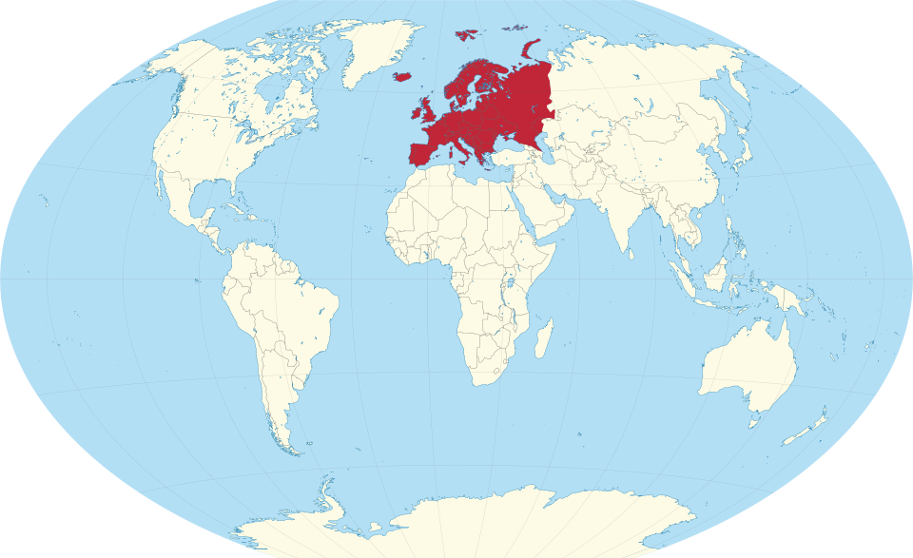
The place of Europe in the global political economy
The perspective of evolutionary political economy
Hardy Hanappi
VIPER – Vienna Institute for Political Economy Research
Technical University of Vienna, Economics, Institute 1053
Hanappi@gmail.com www.econ.tuwien.ac.at/hanappi/

Slide 2
Structure
The Goals of the paper
Europe‘s Evolution since 1918
Skylla and Charybdis
The Art of Walking on Two Legs
The Pragmatics of Loose Ends

Slide 3
The Goals - 1
Organise a division of labour
Typical social characters, institutions and social classes
Continuous capital accumulation
Meets its natural limits
Physical extension of the planet
Unbound loss of orientation of individuals
Doomsday of global capitalism

Slide 4
The Goals - 2
It needs a World Government!
A power representing the entire species
To consider the whole human species as one organism
Humanism
Central nervous system?
Hardware exists due to absolute, global, authoritarian capitalism
Opposing vision of Humanism: Racist Vision:
Individuals of a new and superior race are already among us and only have to eliminate - or domesticate - the rest of the inferior sub humans.

Slide 5
The Goals - 3
An implementation of the humanist vision will need science that is radically different from the war-and-profit science!
Humanism-oriented scientists!
For a racist, the divide of the human population into two parts is the result of the trajectory of a natural process, a kind of unavoidable natural selection of winners over losers.
With the horrors of classical fascism in the first half of the 20th century, the European population should have learned its lesson to avoid the anew takeover by neo-fascist movements.

Slide 6
Europe‘s Evolution
Europe has definitely lost its military significance.
Outpost of US military strategy.
Economic significance: Largest consumer market!
Trump: Instead of consumer good circuits, now weapons and LNG
Destruction of the European Social Model.
Consuming entities are now states – Vassals !
Longer-run oriented political entities implementing cooperative solutions can tame short-run oriented smaller economic entities’ aggressions.
General evolutionary argument:
European unification, therefore can serve as a laboratory for a globally unified political entity.

Slide 7
Skylla and Charybdis
Skylla is seductive
Growth of labour productivity by disequilibrating polarisation
Schumpeter & Marx
Nationalist states as driving political entities
With WW2 Skylla had finally become the monster that negated all progress in human evolution.
Charybdis is complicated
Individuals are not aware how this dangerous swirl drags them into the abyss.
Slowly advancing technological possibilities of mind manipulation of the masses: MMM
MMM enables implementation in the mind of every single individual !

Slide 8
Walking on Two Legs
Local cultural environment and global humanity’s environment.
Europe: Laboratory of future forms of advanced democracy (local and global).
Europe: diversity provides an outstanding playground for intellectual creativity.
Europe: With one leg there’s no walking. Two legs are enough to stand upright, but not enough to walk. Walking needs a direction, needs the idea of progress. Europe is a hotbed for searching and finding progressive directions – science.

Slide 9
The Pragmatics of Loose Ends - 1
The pragmatic specification of the next important goals.
Three important concepts: “the market”, “the state”, and “democracy”.
They can be activated by a closer look at their algorithmic working, at their mechanisms.
Leg No.1 : Mechanisms for the basic institutional framework that could carry the goals of a humanitarian vision.
Leg No.2 : Pragmatic fight against the proponents and carriers of the racist vision.
To walk on both legs, it needs the coordination of both legs.
Europe will have to walk on its own two legs.

Slide 10
The Pragmatics of Loose Ends - 2
New frontlines of the project of European unification:
The Trump-Putin axes of evil, which occurs inside European states as neo-fascism.
The avalanche of MMM confusion, which partly has to rely on science and partly can rediscover local cultural environments that are a not spoiled by nationalist/fascist ideology yet.
Hold neo-fascist political parties in Europe at bay (Skylla-1)
Further develop - in the end control - the handling of MMM (Charybdis-1)
Provide production and consumption algorithms that help to survive the consequences of the climate catastrophe (Skylla-2)
Reach a new understanding of living systems, of their minds and consciousness (Charybdis-2)

Slide 11
The Pragmatics of Loose Ends - 3
The Dollar as the global symbol for social value will disappear, it will be substituted by a democratically-controlled electronic symbol for labour time spent.
Mind-manipulation of the masses (MMM) will be freed from private ownership to return to the dreams of classical enlightenment - but now on the basis of the most advanced type of algorithmically-enhanced technology.
Mind-manipulation of the masses (MMM) will be freed from private ownership to return to the dreams of classical enlightenment - but now on the basis of the most advanced type of algorithmically-enhanced technology.
Global governance, the ‘state’ of the entire human species, will be able to thrive - walking on these two just mentioned feet.
The old capitalist algorithm will become a subject of historic interest, a folly with an important - but limited - historic mission. Instead of accumulation of capital (‘growth’) there will be true innovations, changes of human activities that take into account the finiteness of our planet.

Slide 12
Thank you for your attention
Hardy Hanappi
Hanappi@gmail.com www.econ.tuwien.ac.at/hanappi/
Full Paper: https://hspublishing.org/ASSM/article/view/1223
This PowerPoint file: https://legacy.econ.tuwien.ac.at/hanappi/papers/Place_of_Europe.pptx

