Slide 1
Agent Based Modelling
History, Essence and Future.
Pantheon University Athens
Hardy Hanappi
University of Technology Vienna, Economics
Vienna Institute of Political Economy Research -VIPER
https://en.wikipedia.org/wiki/Hardy_Hanappi

Slide 2
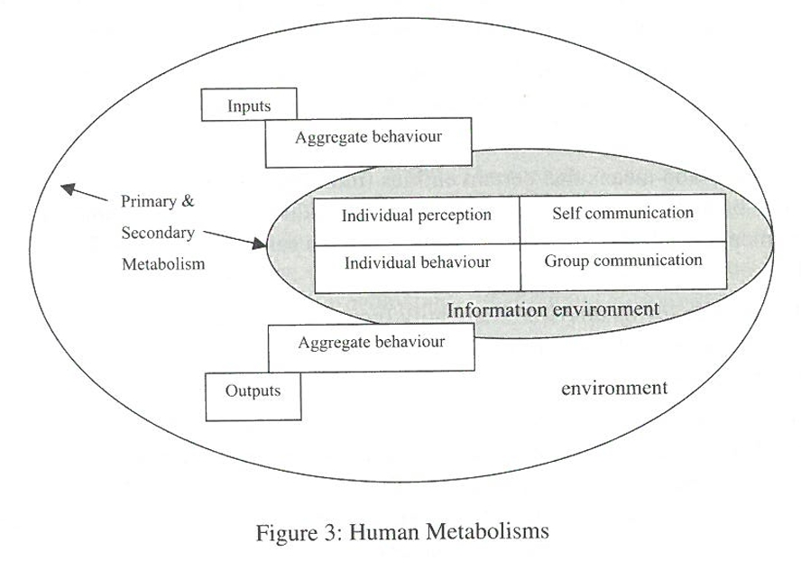
Pantheon University Athens
HISTORY 1
To build an internal model in the brain is the defining characteristic of the human species.
Humans are tool-making animals, which is a process that presupposes internal models
and at the same time produces and modifies them!
Tools are built to copy and to improve our actions.
We live in a two-fold environment of primary metabolism and secondary metabolism.
We live in a two-fold environment of primary metabolism and secondary metabolism.
Compare Hanappi, 2003

Slide 3
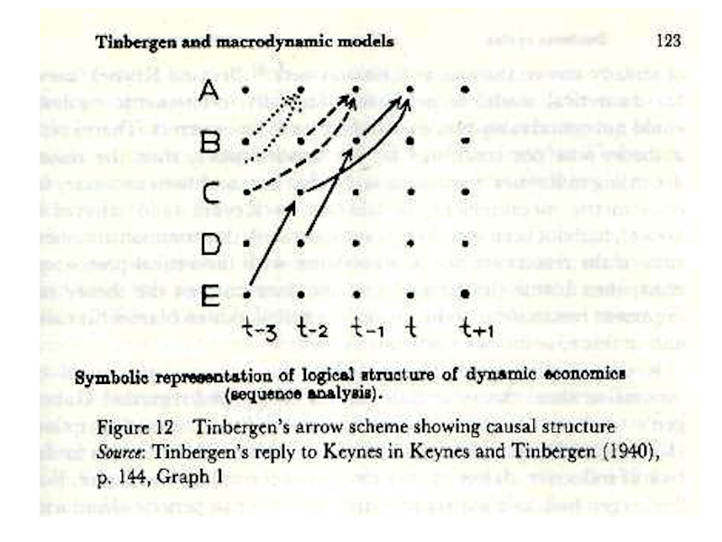
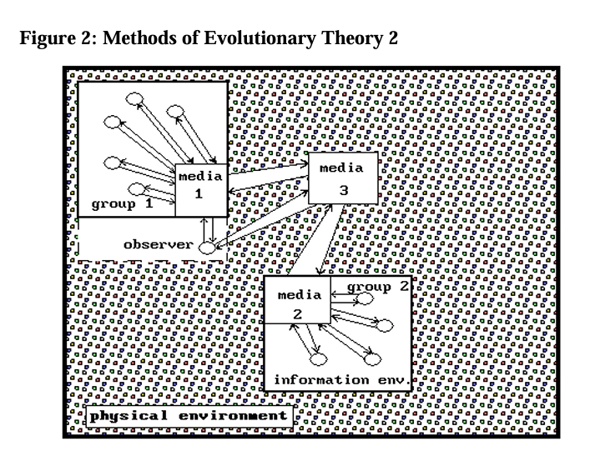
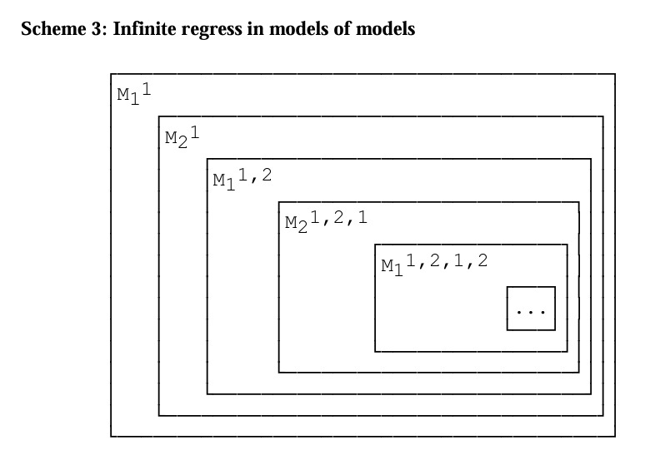
Pantheon University Athens
HISTORY 2
Religious Models: Human individuals are to be seen as imperfect copies of a supernatural being.
Microfoundations of macroeconomics? Microtheology!
Compare Hanappi 2014a
Macroeconomic Modelling: Tinbergen
Game-theoretic modelling: John von Neumann
If games are repeated, a variety of
different behaviours can emerge:
The Hawk Dove Model
Compare Hanappi 2013

Slide 4
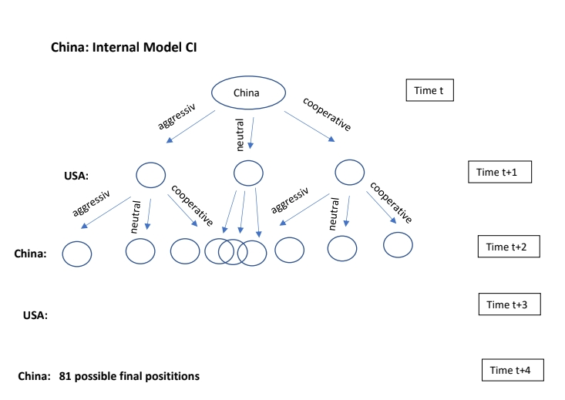
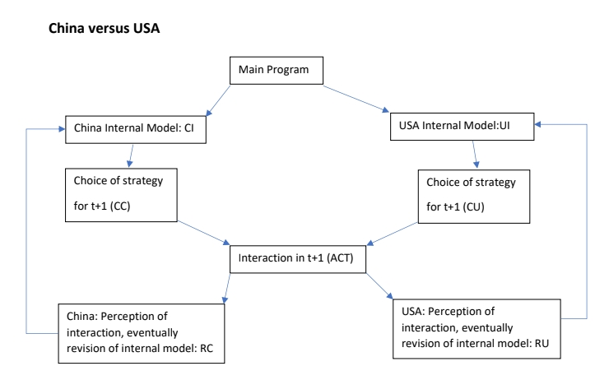
Pantheon University Athens
HISTORY 3
A recipe for constructing an ABM
Compare Hanappi 2017
Step 1: Choose a topic that is closed enough with respect to its environment to allow for an independent
consideration of its internal dynamics.
Step 2: Identify the major agents in your model. Each agent has at least one goal variable and at least
one instrument variable.
Step 3: Construct the internal models of the agents. The result of step 3 is a non-quantified logical blueprint
of the model.
Step 4: Empirical data for all used variables has to be found.
Step 5: Econometric estimation and calibration of the suggested relationships
Step 6: Software implementation of the model. There is a broad range of simulation tools.
The first implementation of a new model is usually considered as a preliminary toy model
Step 7: Systematic results generation by a large number of steadily improved simulation runs.
The overall emerged new knowledge has to be collected, interpreted, and condensed in a report.
Compare Hanappi 2024
Example: China versus USA

Slide 5
Modelling – Stage 1
ESSENCE 1
Pantheon University Athens
External
Perception
Internal
Perception
Received
Theory
Choose the
Problem
Historical
Record
Reduce it to the
Essence
Data driven methods,
e.g. principal components analysis
Identify
Variables & Relationships

Slide 6
Modelling – Stage 2
ESSENCE 2
Inductive
Methods
Deductive
Methods
Econometrics
Axiomatic
Approach
Estimate relationships
Mathematical Economics
Specific Model
is formulated
Interaction

Slide 7
Modelling – Stage 2
ESSENCE 3
Inductive
Methods
Deductive
Methods
Econometrics
Axiomatic
Approach
Estimate relationships
Mathematical Economics
Simulation Model
Theoretical Result
Agent based Simulation
Specific general Result
Heterogenous Agent based Simulation
Comparative Statics
Comparative Dynamics

Slide 8
Modelling – Stage 3
ESSENCE 4

Slide 9
Modelling – Refinements
ESSENCE 5
Modelling internal modelling
External
Perception
Internal
Perception
Qualitative Interviews
Experimental Economics
Game Theory
Evolutionary Economics
Synthesis of Social sciences

Slide 10
Pantheon University Athens
FUTURE 1
Theory
versus
Application
Innovation
Solution-oriented
Agent-oriented
Finance
Military
Speed & Space
Bubbles 2001, 2008, …
Middle East
Ukraine
China - USA
Compare Hanappi & Egger, 1993
Genetic Algorithm
Compare Hanappi & Rengs, 2008
Colonel Blotto Games
Geo-politics
Evolutionary
Game Theory
Compare: Hanappi, 2019
Hanappi, 2022
Compare Hanappi, 2014b
Complex World Money
Compare Hanappi, 2025

Slide 11
Pantheon University Athens
FUTURE 2
Possible Avenues
Larger Tinbergen-type Macro-Simulations of the Global Political Economy
Breakthroughs in understanding and mimicking of brain processes
Acute Danger: Mass media and education implants the capitalist algorithm as
interpretation scheme in all human brains
Advances in institutional design of democracy
Simulation of useful short-cuts to avoid the global climate collapse

Slide 12
Pantheon University Athens
FUTURE 3
Conceivable Dead End of the current hype of business AI applications
(old econometric wine disguised in technologically superficial marketing jargon)
Future paper: Oligarchs, War Lords and Corporation Moguls
Thank You for your Attention !

